Slide 1
PIP4004 - INTERNSHIP Final Review Presentation SCREEN DEVELOPMENT USING EXTENSIBILITY WORKBENCH
Student Details
Name | Yerramilli Sai Prateek
Roll No | 20211COM0042
Section | 8COM-01
Batch No.
Under the Supervision of,
Prof. Mohamed Shakir,
Assistant Professor
School of Computer Science and Engineering
Presidency University
Name of the Program: B.Tech[COMPUTER ENGINEERING]
Name of the HoD: Dr. Gopal Krishna Shyam
Name of the Program Project Coordinator: Dr. Sudha P
Name of the School Internship/Project Coordinators: Mr. Md Ziaur Rahman /
Dr. Sampath A K / Dr. Abdul Khadar A

Slide 2
Content
About The Company
Working domain
About your team and reporting Manager
Challenges Faced in Internship
Objectives of the work
Internship Roadmap
Github Link

Slide 3
PROFINCH SOLUTIONS
Profinch Solutions is a Bengaluru‑headquartered technology consultancy specializing in financial services. Since its founding in 2014, the firm has grown to several hundred employees across India, Singapore, and Dubai .
Profinch helps banks and insurers modernize by combining advisory services with configurable software modules for account management, payments, compliance, and analytics.
Their approach emphasizes rapid time‑to‑value through reusable components and best‑practice process frameworks​.

Slide 4
DEVELOPMENT DOMAIN
To extend the core engine without touching its base code, banks use a metadata‑driven extensibility toolkit.
This toolkit generates service skeletons, UI fragments, and database scripts—allowing developers to plug in new workflows (e.g., customized loan‑approval checks or fee‑calculation services).
These extensions run alongside the core modules, register with a central service directory, and expose RESTful endpoints for front‑end applications​.
During my internship, I used this toolkit to scaffold, implement, and test several new microservices in a sandboxed environment.

Slide 5
Team and reporting Manager
Development and Customisation Team.
Currently reporting to Mrs. Veena BA and Mr. Yathish DC.

Slide 6
Challenges Faced in Internship
Was asked questions regarding SQL, Data Structures like Linked List, Arrays, Stack.
Adjusting to the new work atmosphere initially.
Researching about working of Banking, its different payment methods and accounting.
Learning PL SQL, Spring Boot and the tools used by the company.
Solving errors by tracing the logs using logging tools.

Slide 7
Objectives of the work
Exploring Core Banking Engines
Gaining Experience with an Extensibility Toolkit.
Building Expertise in a Modern Fintech Stack
Navigating The Software Lifecycle in Financial Projects
Strengthening Troubleshooting and Debugging
Fostering Effective Teamwork and Communication
Linking Development to Business Impact

Slide 8
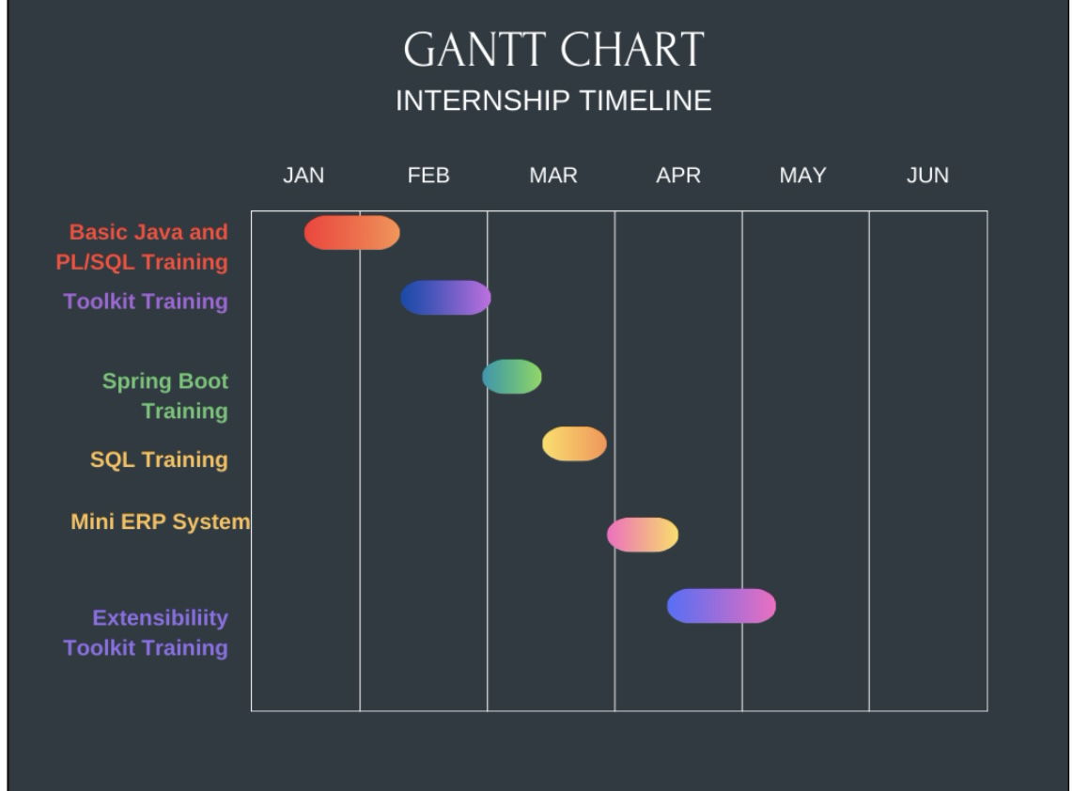
Internship Road Map

Slide 9
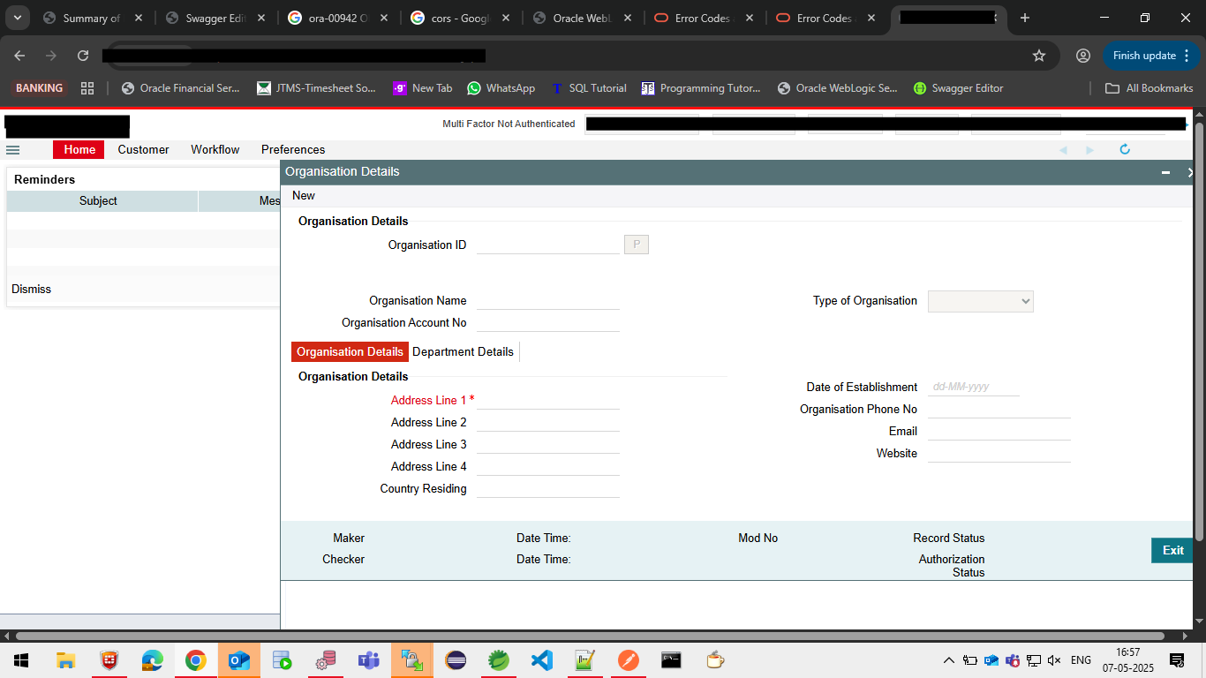
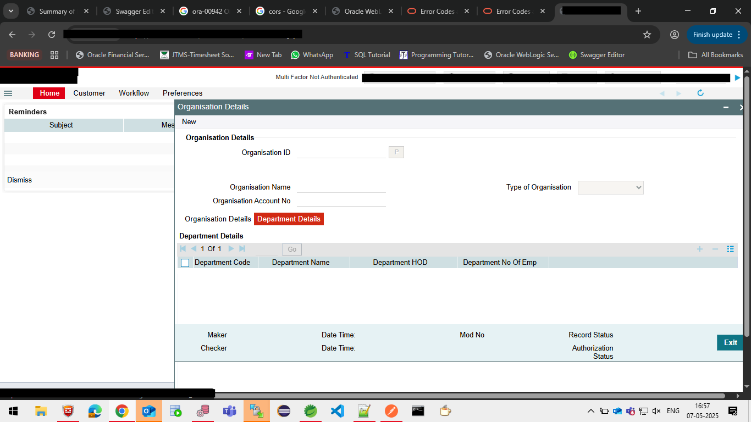
Obtained Results
Pic 1. CBS single-record screen
Pic 2. CBS multi-record screen

Slide 10






SDG Mapping
Engaging directly in banking software projects bridged the gap between theory and practice, strengthening my core programming, database, and system‑design skills
Contributed to fintech innovations that support efficient banking operations. Built professional skills and work ethics needed for economic productivity.
Encouraged efficient resource use and minimal redundancy in backend systems. Promoted optimal software design for better performance and sustainability.
Promotes inclusive workplace culture and collaboration regardless of gender. Equal opportunity to learn, grow, and contribute in a professional environment.
Worked on modern banking infrastructure solutions. Involved in microservices architecture, enhancing system scalability and innovation.
Collaborated with teams, clients, and possibly vendors, contributing to shared global objectives in fintech.

Slide 11
Github Link
https://github.com/Prateek2617

Slide 12
Q&A

Slide 13
Thank you !!

